Slide 1


XMPP Tech: Messaging & Presence Protocol
“Simplifying Business Communications”

Slide 2





Importance of XMPP
Online
presence
stronger
trust
quicker
responses
faster
deals
creates
which leads to
resulting in

Slide 3



XMPP at IndiaMART
Platform independent implementation

Slide 4
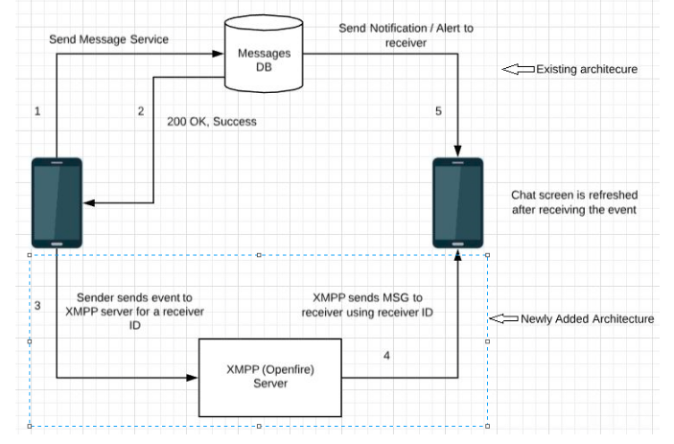
XMPP Implementation

Slide 5
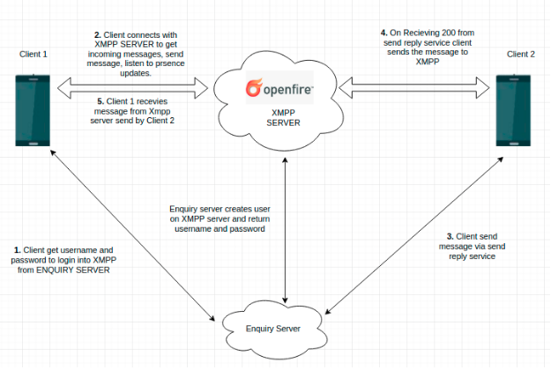
XMPP Working

Slide 6
Performance Measure
Response Time (in ms) | 3rd Mar - 9th Mar
Make the connection from client to server | 1400
Authenticate and login the user | 2820
User creation service | 271
Deliver messages from client 1 to server | 2
Deliver messages from server to client 2 | to be calculated *
Response time of presence service | 294
Number of connections | to be calculated *
Number of requests of send messages | to be calculated *
* will be shared from next review

Slide 7
Current Challenges
Challenges | Tentative Dates
Persistent high load on chat server | 2nd week of April
Connection time out while connecting with chat server | 2nd week of April
Optimization of internal database used by XMPP | 4th week of April

Slide 8
Thank You!

